Slide 1
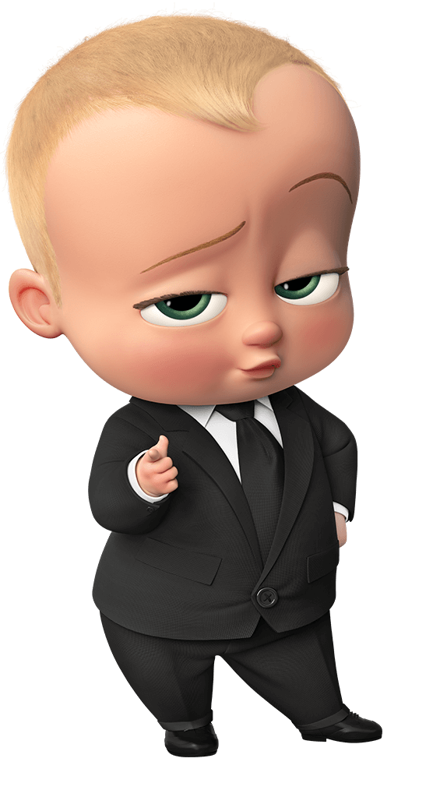
Parts of body

Slide 2
head

Slide 3
shoulders

Slide 4
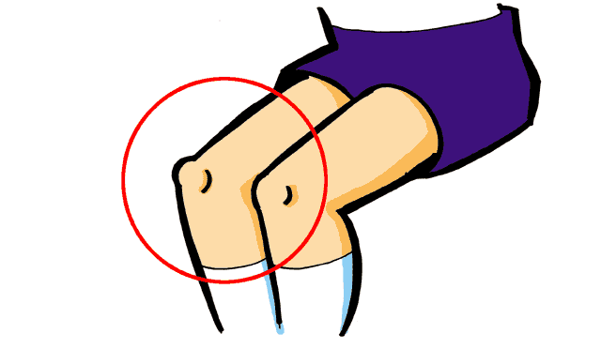
knees

Slide 5
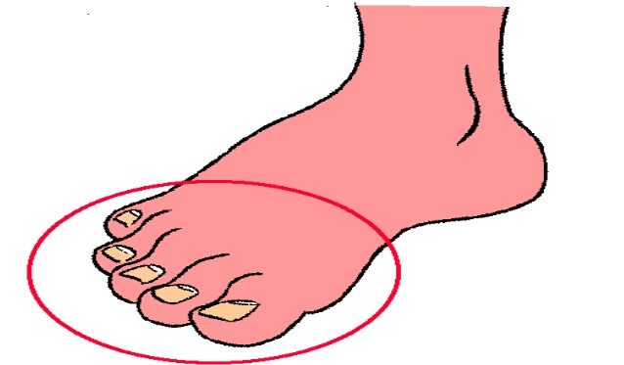
toes

Slide 6
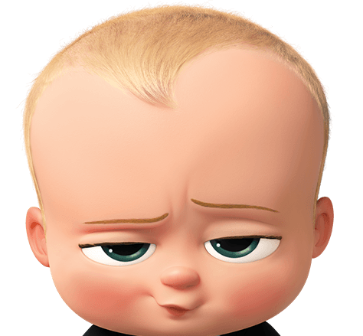
eyes

Slide 7
ears

Slide 8
mouth

Slide 9
nose

Slide 10
love

Slide 11
like

Slide 12
I love my ears.

Slide 13
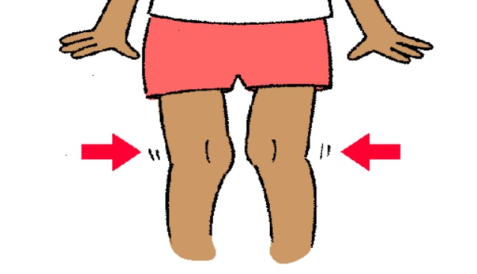
I love my _____.

Slide 14
I like my toes.

Slide 15
I like my _____.

Slide 16
แหล่งอ้างอิง
https://www.youtube.com/watch?v=ka7d-13iWbA
Head, Shoulders, Knees & Toes Tablet Giveaway!.mp4
รูปภาพจาก https://www.pngall.com/th/the-boss-baby-png/download/51991
https://www.pngall.com/th/the-boss-baby-png/download/52033

